Slide 1


KVGCE HACKWISE
TECHIES
Problem Number:03

Slide 2

Fuel optimization in space missions is crucial for ensuring spacecraft can efficiently navigate between waypoints while conserving limited fuel resources. The goal is to determine the most fuel-efficient path, where fuel consumption is directly proportional to the Euclidean distance between waypoints. This optimization problem is vital for long-duration missions, as it ensures spacecraft can complete their objectives, such as visiting multiple targets or conducting scientific research, without depleting their fuel supply. Effective fuel management extends mission durations, reduces costs, and minimizes the risk of mission failure due to fuel shortages.

Slide 3
Solution Approach
Branch and Bound Algorithm:
Branch and Bound is an algorithmic method used to solve optimization problems. It works by dividing the main problem into smaller subproblems (called branching), calculating the best possible solution each subproblem can give (called bounding), and eliminating subproblems that cannot improve the current best solution (called pruning). This approach reduces the number of solutions that need to be checked, making the algorithm more efficient. It is commonly used in problems like the Traveling Salesman Problem

Slide 4
Implementation
1.Loading waypoints:
2. Create Distance Matrix:
waypoints = []
with open("waypoints.txt") as f:
for line in f:
id, x, y, z = map(float, line.strip().split())
waypoints.append((int(id), x, y, z))
for i in range(N):
for j in range(N):
dist[i][j] = math.sqrt((x2 - x1)*2 + (y2 - y1)2 + (z2 - z1)*2)
#Reads the 3D coordinates (x, y, z) and ID of each waypoint from a text file.
#Calculates the straight-line (Euclidean) distance between every pair of waypoints in 3D space.

Slide 5
3.Bound Function:
4.Main Branch and Bound Algorithm
def calculate_bound(path, visited): ...
def branch_and_bound_tsp(): ...
#Estimates the minimum remaining cost to finish the route.
Used to decide which paths are promising.
#Uses a priority queue to explore the most promising paths first.
Skips paths that already look too costly.
Keeps track of the best (shortest) full path found

Slide 6
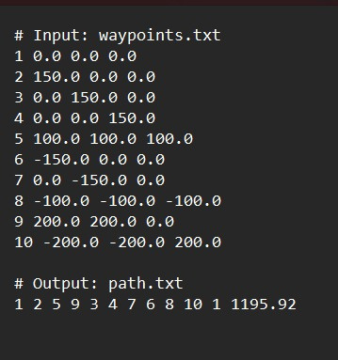

Result

Slide 7
TEAM MEMEBERS
Mohammed Saalihi Ali
Abdul Samhoon
Frontend Development
Algorithm Implementation
Algorithm Implementation
Testing and Debugging
Harshith R Acharya
Mohammed Aife
Algorithm Implementation
Documentation
Testing and Debugging
Documentation
-

Slide 8
REFERENCES
Reference
Libraries used :
Math
Heapq
The Traveling Sales Man problem : when good enough beats perfect by Reducible.
The traveling sales man series by Eddie woo.
Traveling Sales Man Problem visualization by n sanity.
Sites Used
Google colab
Youtube
ChatGpt

Slide 9
Thank You

